Slide 1


Communications’ role in decoding sustainability agenda
Camila Limberg
PROI Worldwide ESG Group member
Notes:
Good afternoon everyone! It is a great pleasure to be here. I am Camila. I work at Grupo Imagem Corporativa in Brazil, which is one of more than 80 PR agencies part of PROI Worldwide. I am here with my colleague Rania, from egypt, and I am representing our ESG Group. Inspired by the many discussions we had last year, with members from different parts of the globe, Today I am gonna talk about roles and responsibilities of PR agencies and communicators in the context of urgent sustainable development challenges. How are these professionals bringing together their knowledge and energy to help different stakeholders to understand the sustainability agenda and mobilize them towards action? But Before we start I would like to properly introduce you to PRIO Worldwide

Slide 2


Slide 3
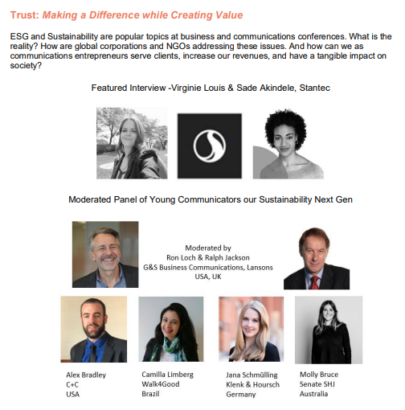
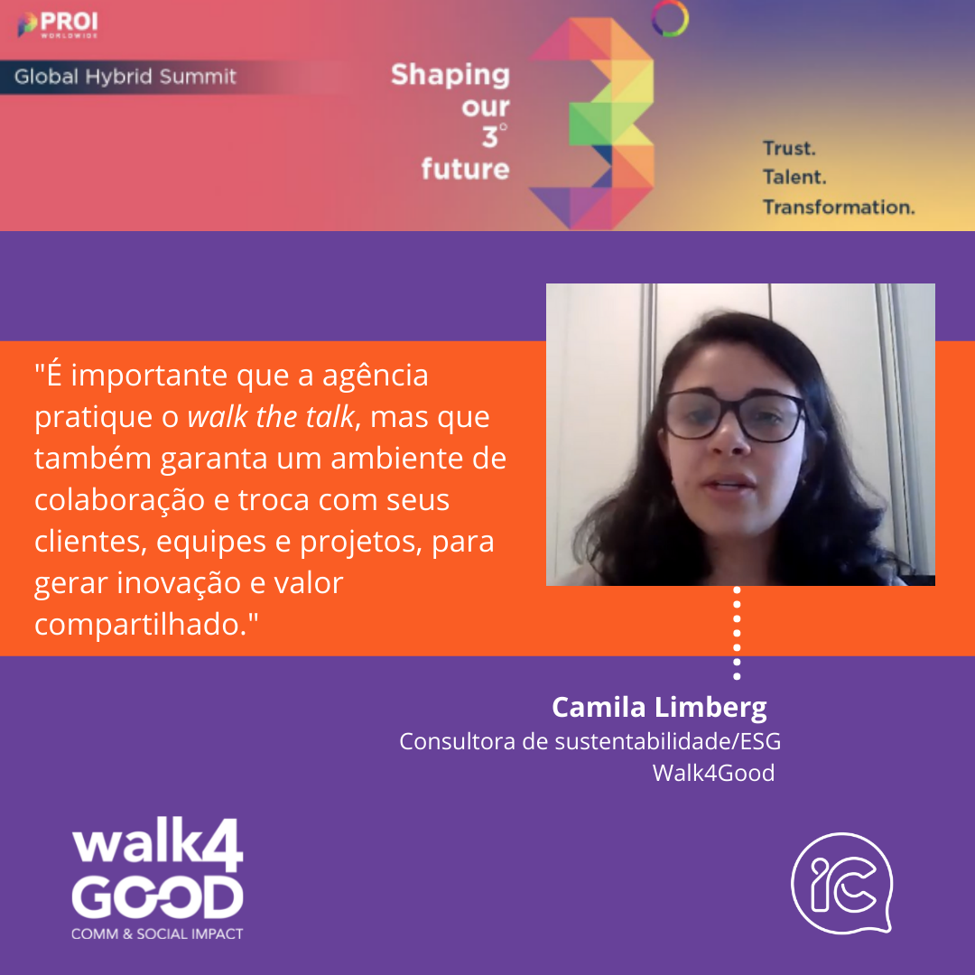
Our work at PROI Worldwide
Notes:
As I mentioned in our ESG Group (here you can see some of the participants) we have been discussing our role towards sustainable Development and how we, can create shared value. Our role is exactly to build this bridge between knowledge in sustainability and what the various diferente stakeholders want to know. And to build this bridge we need to embeddi this agenda in our products, but also Walk the talk. So in terms of how we help clientes, there is a variety of ways we can help, from bringing sustainability topics to media training and preparing speakers or sponsors of this agenda in the organization, ultil mapping reputational risks if the organization is acused of greenwashing. But there is also another key aspect to foster this agenda: and this is walk the talk to also engage our employees, retain talents and build trust. It is importante that employees also recognize the values and purposes of the company in their daily work. If i tell my clientes diversity is good to create innovative environments and i am not putting na effort to create this environment in my agency, chances are that you wont be recognized as able to deal with this topic

Slide 4
Sustainability agenda today
Notes:
Before further discussing our roles and responsibilities in more depth, I would like to bring together some of the things we know. Where are we today and where are we moving towards?

Slide 5
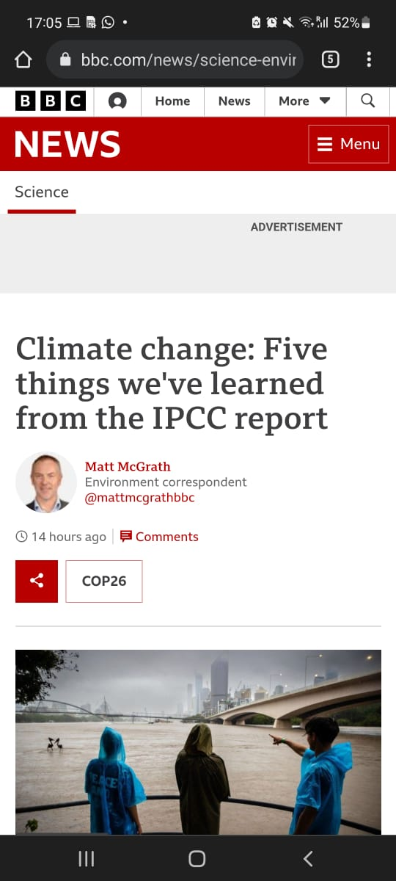
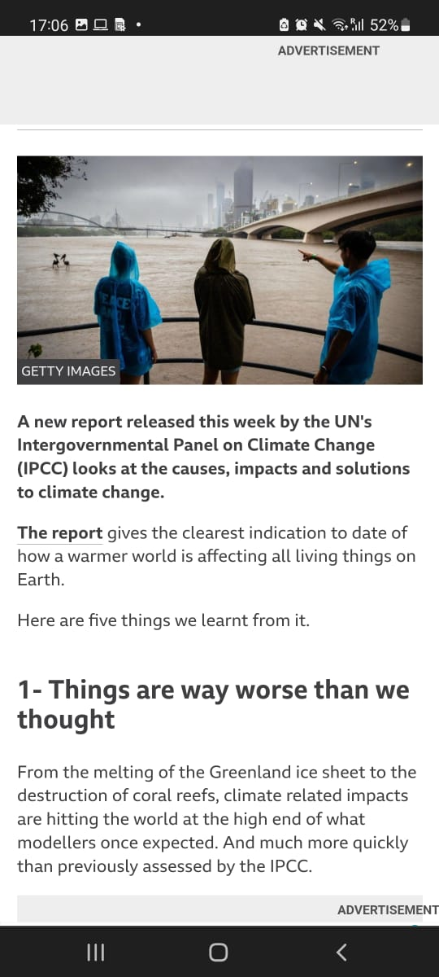
Things are worse than we thought
Loss and damage gets scientific backing
Technology is not a silver bullet
Cities offer hope: key places for mobilization
The small window is closing fast
Notes:
I would like to start with a very fresh publication, but not necesssarily new. Earlier this week the IPCC has published its new report, looking at the causes, impacts and solutions to climate change. And there are five main topics they conclude on
But what I want to highlight here is that these topics are very connected to communications. They bring the sense of urgency and preparedness to address this new reality. Which are two key roles of communication, to translate sustainability to differente staleholders in order to mobilize people
https://www.bbc.com/news/science-environment-60541816

Slide 6
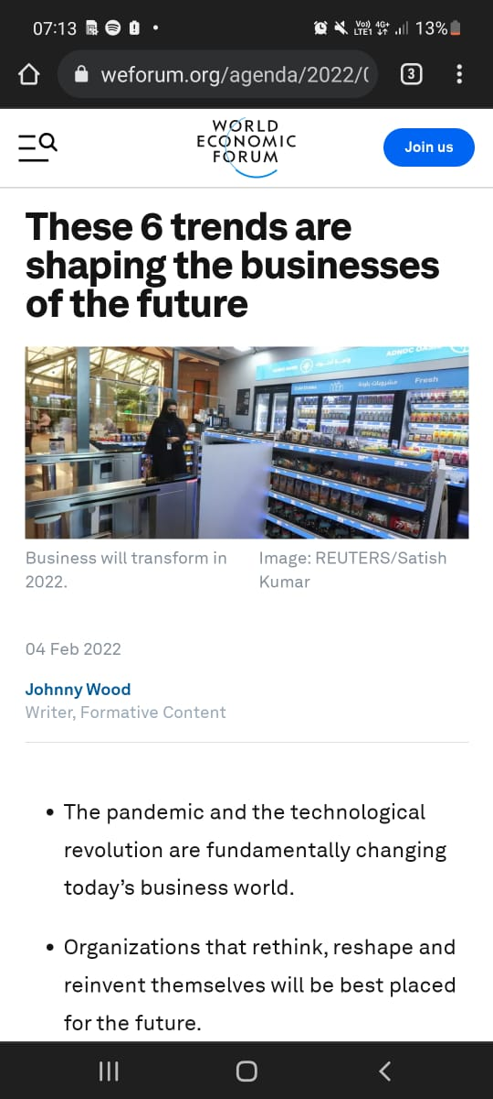
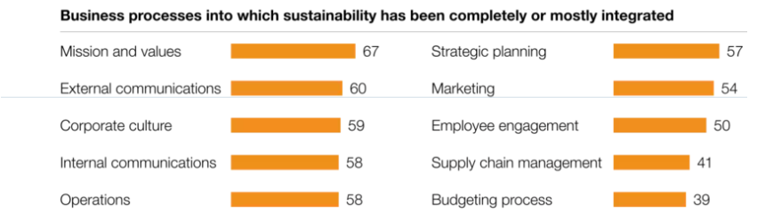
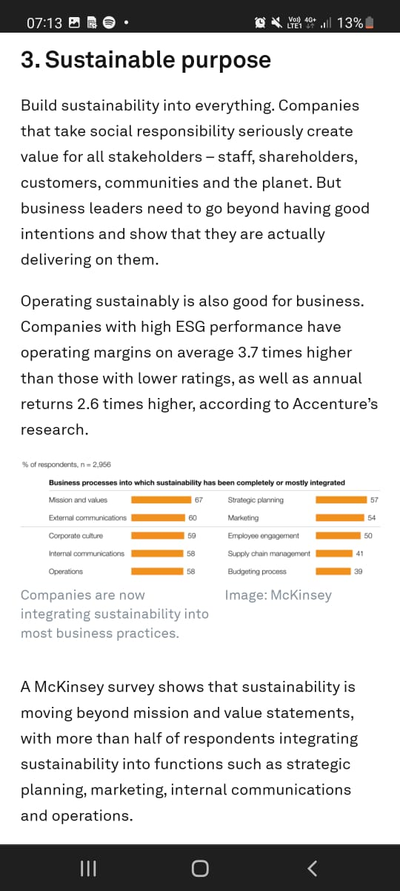
Global trends
Source: Business Futures 2021: Signals of Change, by Accenture on World Economic Forum
Notes:
Acccording to recently published article by World economic fórum studies from accenture and mackinsey, globally in 2021. there are 6 main trends shaping the future and the main one is sustainable purpose: creating shared value for all stakeholders. So we can see here evidence of organizations embeding sustainability in their businessess in many diferente ways.. And it requires companies to go far beyond good intentions and adopt this agenda strategically. And what we can also see here is that most of them are communicating this trhough their mission and values, but there is still gap and many opportunities to advance this implamentation. Here some of the challneging points we usuallty here from clientes is supply chain management. It has been one of the main forces pushing the sustainability agenda, once one big company stratr requiring things from its suppliers, we have a whole chain forced to adapt to survive

Slide 7
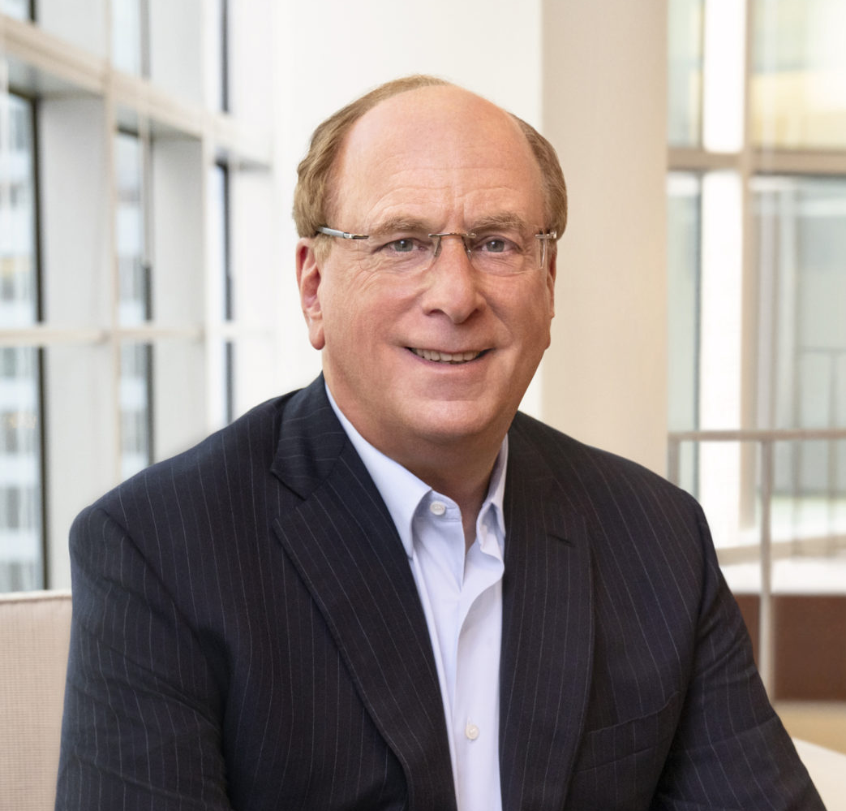
The future is now
“The Power of Capitalism”
Money available to innovate
Climate risk = investment risk
Next unicorns will be innovative, sustainable and scalable
Sustainable investments have now reached $4 trillion
“Every company and every industry will be transformed by the transition to a net zero world. The question is, will you lead, or will you be led?”
Larry Fink – CEO Black Rock
Larry Fink’s 2022 letter to CEOs
The Power of Capitalism
Notes:
And things are really advancing! This agenda is been more and more influenced by the financial market
Larry Fink this year, on his annual letter to the market, and he raises interesting points about the power of capitalism. He also highlights that Every inddustry will be transformed, eaither leading or being led by others. We know that some organizations are taking the lead (and here I can mention the situation in my country, in Brazil, Where we dont really have the support from government towards sustainable Development, but big national aand multinational companies are taking the lead, either because They realized the many benefits related to na strategic agenda or because they are being pressured by regulators, or clientes for example.

Slide 8

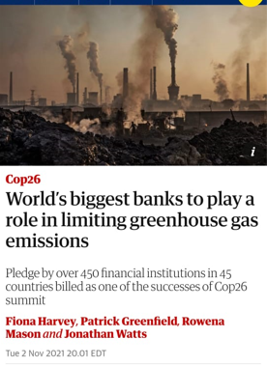
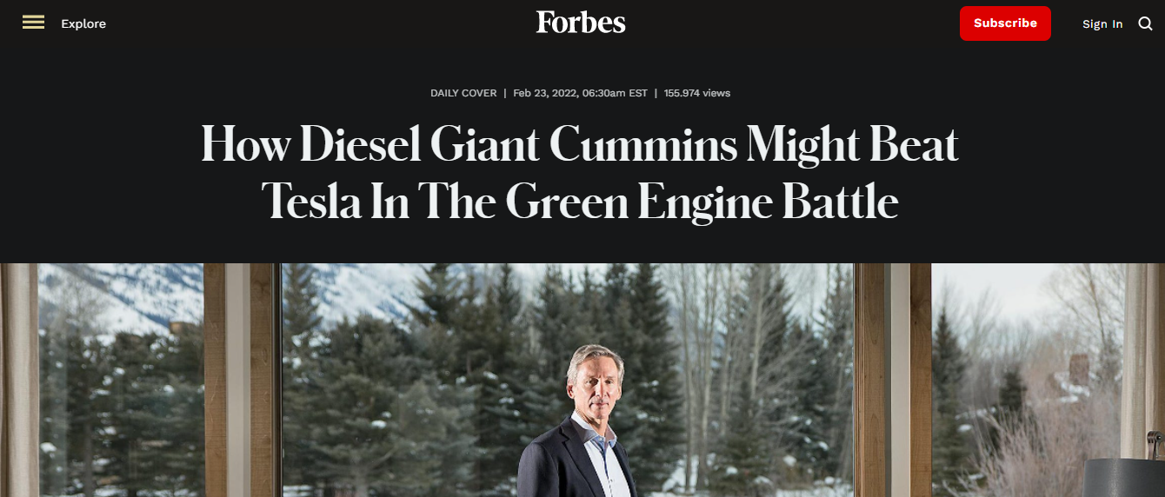
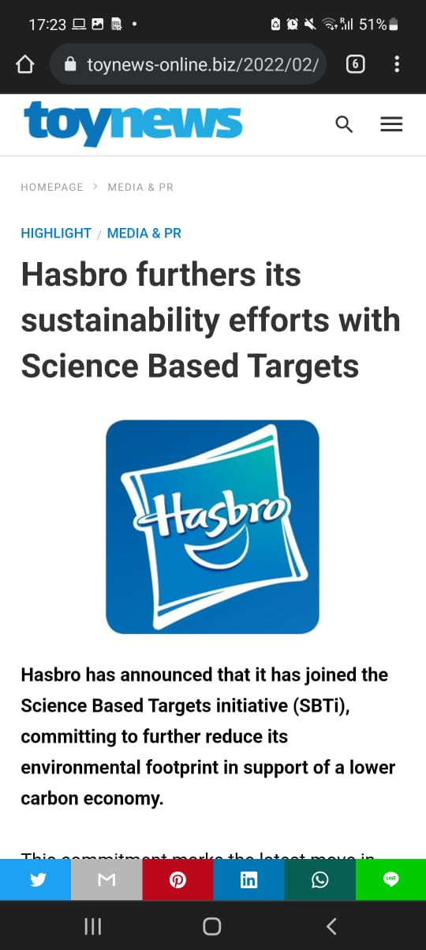
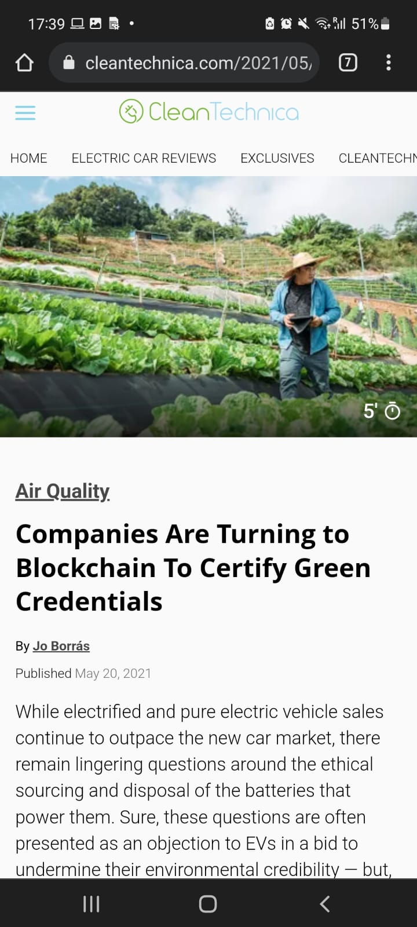
The future is now
Notes:
And there is already a variety of companies on the run towards green innovation and transformation, complying with regulations and goying far beyond with innovative initiatives. These initiatives have been largely publicized and raising awareness of the public about the sustainable aspects of products and services
https://www.forbes.com/sites/alanohnsman/2022/02/23/how-diesel-giant-cummins-might-beat-tesla-in-the-green-engine-battle/?sh=3a68a79743c8
https://cleantechnica.com/2021/05/20/companies-are-turning-to-blockchain-to-certify-green-credentials/
https://economictimes.indiatimes.com/small-biz/sme-sector/business-models-along-the-south-south-corridor-can-spur-regional-trade-sankalps-urvashi-devidayal/articleshow/89718586.cms

Slide 9
Responsibility and role of communications
Notes:
So, in this scenario of multiple interconnected challenges, efforts and initiatives that demand collaboration and increasing opportunities for change..what is the role of communications? How we create shared value?

Slide 10

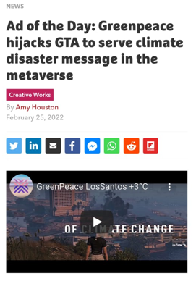
raise awareness
Challenges
Language barriers
Willingness to change
Access to information
Notes:
Thinking of that jorney of Building the bridge from knowlege to communicate , the level 1 challenge is raise awareness and this is challenging because of many aspects. Most of scientific studies are in english, but most of population do not speak english. Another challenge relates to tThe perception of the problems affect people differetly and this influences their willingness to change. Besides that different generations access and absorb information in very diferente ways.
A very good example of how to raise awarenss combining technology and modern language to reach na specific audience is the case of Greenpeace and GTA. Greenpeace has recently announced this campaign to raise awareness around climate change. Greenpeace. Following the metaverse trends, and in partnership with this famopus videogame, GTA, they created a server that uses de map on the videogame, but affected by catastrophic events related to the climate crisis. https://exame.com/future-of-money/greenpeace-leva-crise-climatica-para-o-metaverso-em-parceria-com-jogo-gta/
https://www.reptrak.com/blog/capturing-stakeholder-attention-through-esg-communication-data-science/

Slide 11
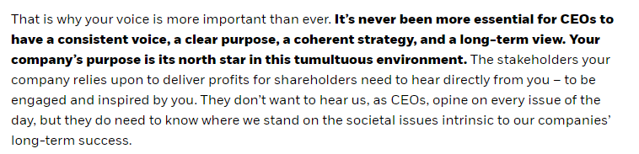
Communicate strategically
Larry Fink – CEO Black Rock
Larry Fink’s 2022 letter to CEOs
Notes:
As I said, for the communication to reach effectively the different audience there must be a good strategy but before that the sustainability agenda must be clear for the organization. As Larry fink also mentioned on his newst letter, there must be a strong voice communicating a strong purpose, a coherent strategy and a long term view. So many companies nowadays still don’t know their real impacts (environmental, social, economic) and also don’t know how they create shared value
Need to define strategies to communicate with different audiences making sure all stakeholders understand the message. It might sound basic to have a strategy, but many companies struggle to build on this strategy, show how the business is understanding its impacts and opportunities to create sshared value, and going further, how the company plans to do that, what are the goals, what are the priorities?

Slide 12

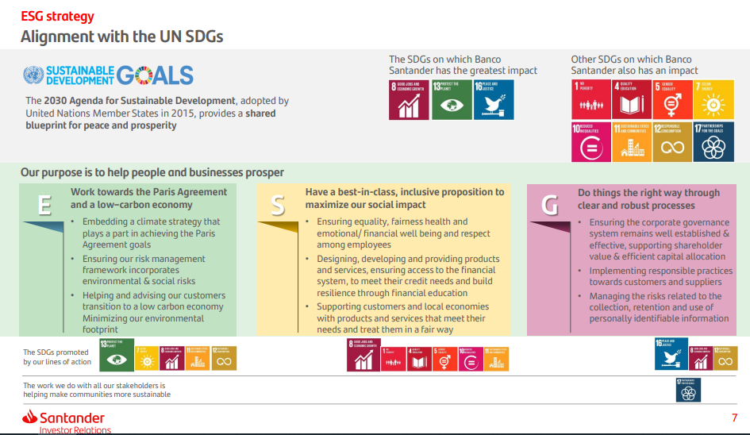
Communicate strategically
Notes:
Example on clear purpose
https://www.santander.com/content/dam/santander-com/en/documentos/esg-presentation/2022/do-esg-presentacion-1h-22-en.pdf

Slide 13
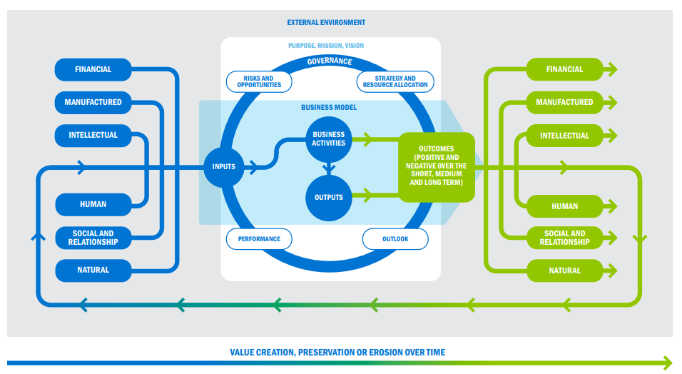
Communicate strategically
Source: IIRC Revised Framework, 2021
Notes:
another chart here showing a tool to comunicate shared value. To define and comunicate all those key aspects there are diferent methodologies. But there is one tool that is very helpful for organizations to start changing this mindset and understanding how They use their resources, how They operate, their impacts and how They create shared vale. This tool comes from the integrated reporting framework, which has now , during COP26, joined forces with sasb to create the ISSB (International Sustainability Standards Board).

Slide 14

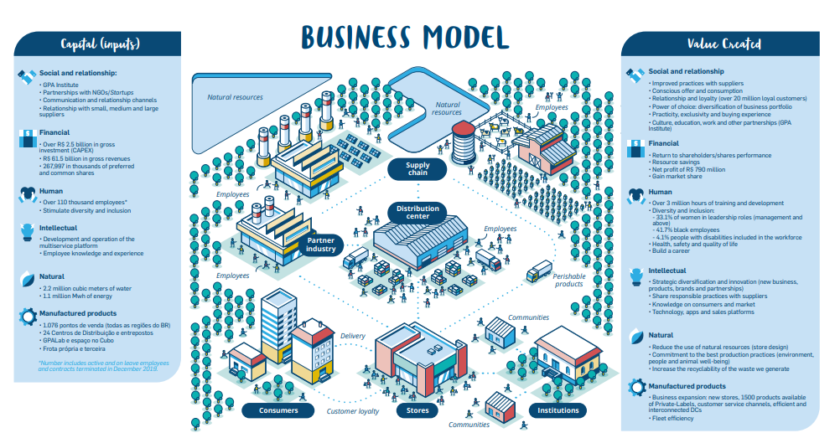
Communicate strategically
Notes:
To define and comunicate all that there are diferent methodologies. But there is one tool that is very helpful for organizations to start changing this mindset and understanding how They use their resources, how They operate, their impacts and how They create shared vale. This tool comes from the integrated reporting framework, which has now , during COP26, joined forces with sasb to create the ISSB (International Sustainability Standards Board).

Slide 15
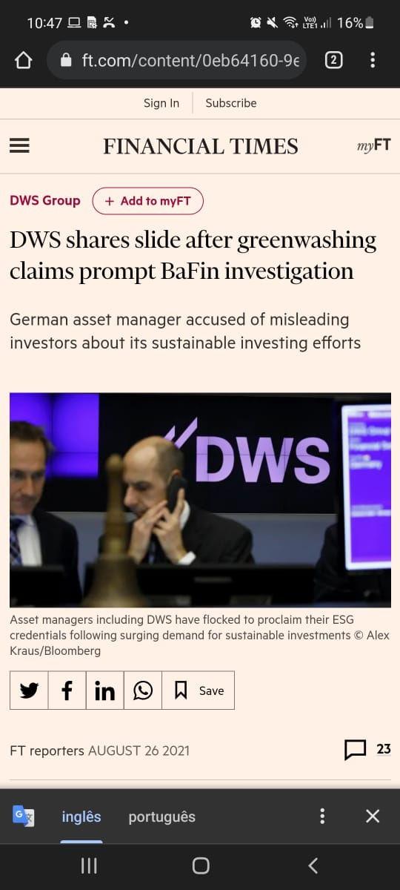

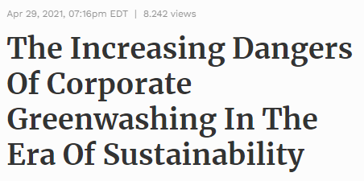
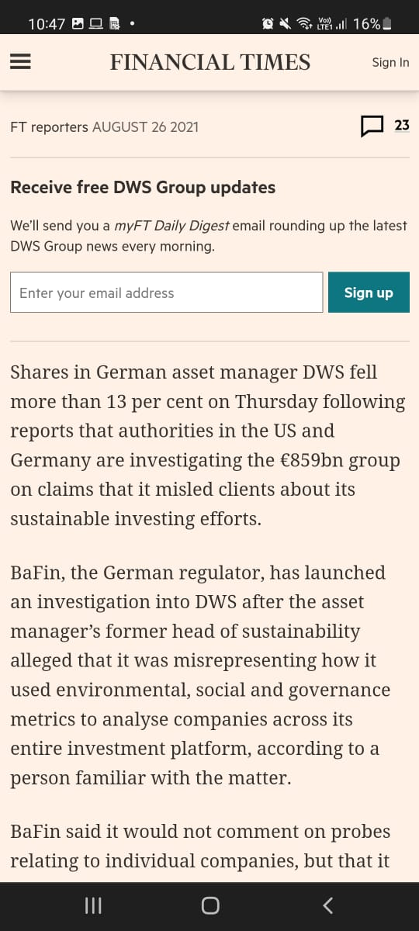
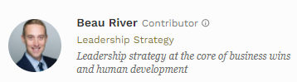
Be transparent and build trust
Risks: From public perception to loss of market share
Notes:
https://www.ft.com/content/0eb64160-9e41-44b6-8550-742a6a4b1022
https://www.forbes.com/sites/beauriver/2021/04/29/the-increasing-dangers-of-corporate-greenwashing-in-the-era-of-sustainability/?sh=1c5ef3424a32
Need to be transparent in order to build trust among all stakeholders, attracting and retainig talents, accessing more investments, generating shared value and avoid crisis. We have already seen many cases of companies acused of greenwashing or social washing, like Volkswagen, Starbucks, H&M…and many others that suffered with boicots and a erious reputational damage because of this.
Falar aqui do case de job rotation da coca no brasil
https://earth.org/greenwashing-companies-corporations/
https://www.riotimesonline.com/brazil-news/brazil/latin-americas-largest-fintech-brazilian-nubank-apologizes-and-vows-historical-reparation-agenda/
https://labsnews.com/en/news/business/nubank-to-fund-the-education-of-black-programmers-after-controversy/
https://www.nasdaq.com/articles/brazils-nubank-says-it-failed-vows-racial-diversity-after-founder-stirs-controversy-2020
https://guardian.ng/guardian-woman/those-unprepared-for-crisis-management-pay-a-high-price/
Need to be creative and explore the variety of possibilities to communicate to different audiences (publications, social media, events…)
Need to prepare porta vozes to raise awareness about differente topics and prepare them to be able to navigate among sensitive topics
Com o posicionamento de cada um, (grandes polos de iniciaticvas necessarias sao governos e empresas), é possível mobilizar, viabilizar conexões e parcerias (a própria proi tem feito isso de forma muito bem sucedida, com colaborações internacionais, troca de experiencias e construções conjuntas). como ajudamos empresas a mobilizarem colaboradores e cadeia de valor a aderirem a esses compromissos.

Slide 16
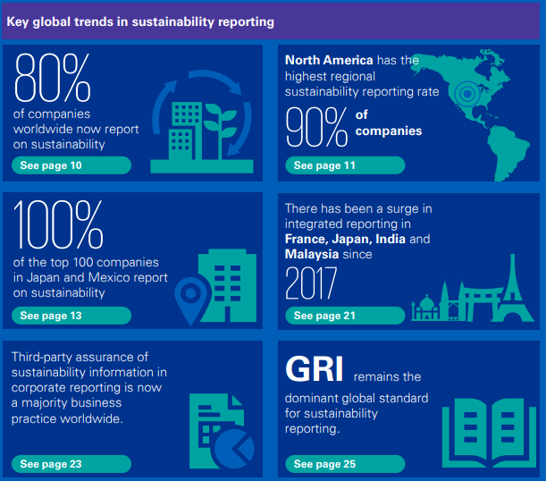
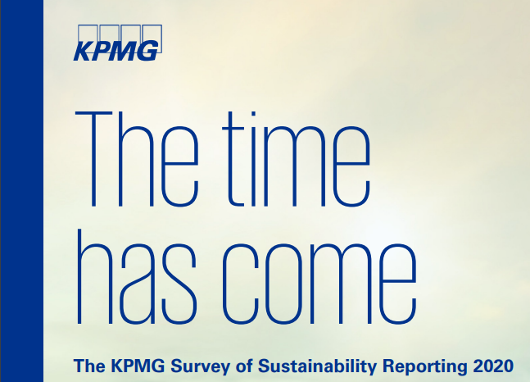
Be transparent and build trust
Notes:
Need to be transparent in order to build trust among all stakeholders, attracting and retainig talents, accessing more investments, generating shared value and avoid crisis and here we see the evergrowing sustainability reports as a key tool. As you can see from this KPMG study, run in 52 countries and 5200 organizations, 80% of companies worldwide now report on sustainability and the main framework used for that is GRI, which has 10 principles to guarantee quality and transparency on the report. Beside GRI, we have other frameworks and approaches also looking for quality assurance, such as SASB and integrated report. GRI also requires the materiality assessment to define the content of the report, making it objective and aligned with the organizations priorities, according to their tipe of business and inputs from internal and external stakeholders.

Slide 17
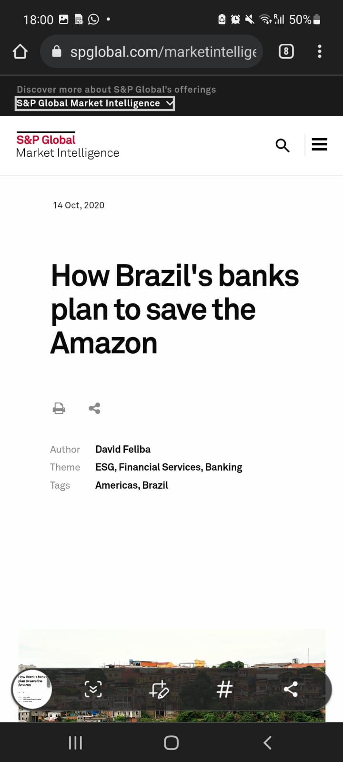
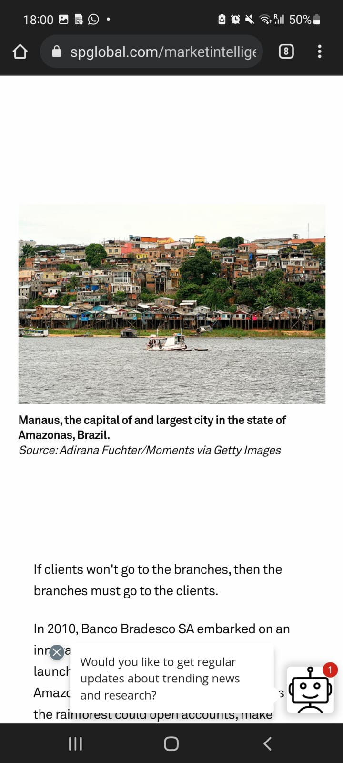
Collective action
“Amid renewed interest in ESG stemming from the impact of COVID-19, the top three private banks in the country launched the "Amazon Plan," a multi-layered program by Bradesco, Banco Santander Brasil SA and Itaú Unibanco Holding SA that seeks to foster growth and advance inclusion among people who live in the remote areas”
Notes:
Falar das parcerias em eventos, falar do hospital..de muitos momentos em que tem essa construção de confiança e transparência nos resultados para construir algo maior
Comunicam bem..mostram o que estão fazendo e aonde querem ir...isso permite aproximações
https://www.weforum.org/agenda/2022/01/net-zero-public-private-unity-pwc/
https://exame.com/esg/bradesco-itau-e-santander-criam-conselho-para-desenvolver-a-amazonia/
https://www.spglobal.com/marketintelligence/en/news-insights/latest-news-headlines/how-brazil-s-banks-plan-to-save-the-amazon-60607341#:~:text=Amid%20renewed%20interest%20in%20ESG,who%20live%20in%20the%20remote
Os três maiores bancos do Brasil, Bradesco, Itaú e Santander, anunciaram, hoje, os nomes que irão compor o Conselho Consultivo da Amazônia. O grupo foi criado para apoiar a implementação das dez medidas para o desenvolvimento sustentável da região, que foram propostas pelas instituições financeiras no mês passado.
“Estamos muito satisfeitos por reunir este grupo altamente qualificado e que conhece profundamente os desafios do Brasil na área ambiental e, mais especificamente, na Amazônia”, afirma Candido Bracher, presidente do Itaú Unibanco. “A colaboração dos conselheiros consultivos será fundamental para que nossa atuação na região seja efetiva e gere os impactos positivos que buscamos.”
Fazem parte do conselho:
Adalberto Luís Val, pesquisador do Instituto Nacional de Pesquisas da Amazônia (INPA)
Adalberto Veríssimo, pesquisador associado e co-fundador do Imazon
André Guimarães, diretor-executivo do Instituto de Pesquisa Ambiental da Amazônia (IPAM)
Carlos Nobre, cientista destacado principalmente na área dos estudos sobre Mudanças Climáticas e Amazônia e atual responsável pelo projeto Amazônia 4.0
Denis Minev, diretor-presidente das Lojas Bemol e co-fundador da Fundação Amazonas Sustentável
Izabella Teixeira, ex-ministra do Meio Ambiente (2010-2016)
Teresa Vendramini, presidente da Sociedade Rural Brasileira
As 10 medidas para desenvolver a Amazônia foram apresentadas pelos bancos ao Governo Federal. A constituição do conselho já estava prevista. A ideia é que os cientistas trabalhem no detalhamento das medidas e no estabelecimento das metas.
O grupo também será responsável por acompanhar os desdobramentos dos planos e por criar métricas e objetivos alinhados aos desafios locais. As ações — que estão previstas para começar ainda neste ano — serão coordenadas com o governo e implementadas em parceria com as iniciativas públicas.
Notícias relacionadas
ESG
Há 2 anos10 princípios para explorar a Amazônia sem desmatar
ESG
Há 2 anosGrandes empresas clamam por proteção à Amazônia
“Queremos dar passos concretos para tornar o discurso em realidade. A Amazônia não é um problema. O ato de proteger a Amazônia guarda boa parte das respostas corretas para um mundo que tem dúvidas e incertezas”, afirmou, no dia do anúncio das medidas, Octavio de Lazari Junior, presidente do Bradesco.
Para Sérgio Rial, presidente do Santander Brasil, a dimensão do desafio impõe uma atuação firme e veloz a todos os atores. “Com a união de esforços de nossa indústria, conseguiremos fazer ainda mais por essa região, que tem um valor inestimável não só para o país, mas para todo o planeta”, diz.
Entre as ações que farão parte desse plano, estão:
Estimulo às cadeias sustentáveis na região (cacau, açaí e castanha) por meio de linhas de financiamento diferenciadas e/ou ferramentas financeiras e não financeiras
Viabilização de investimentos em infraestrutura básica para o desenvolvimento social (energia, internet, moradia e saneamento) e ambiental (transporte hidroviário)
Fomento de um mercado de ativos e instrumentos financeiros de lastro verde
Atração de investimentos e promoção de parcerias para o desenvolvimento de tecnologias que impulsionem a bioeconomia
Apoio para atores e lideranças locais que trabalhem em projetos de desenvolvimento socioeconômico na região

Slide 18




Sustainability communication journey
trust and transparency
Engage and be transparent to build trust and prevent communications crisis and scandals. Give equal attention to internal and external stakeholders
decode
“translate” the reality and raise awareness. Tailor the message for diferente audiences
make it strategic
Define a strategy to reach your audience and consistently communicate. Prepare speakers and own the narrative. Engage the influential
collective action
Measure impact and communicate shared value creation to engage and maintain trust
Notes:
entender esse cenário e multiplicar essas percepções de urgência...mobilizando, educando, levando informações: comunicação interna
conhecimento e noção de urgencia e termos a possibilidade de multiplicar essas percepções ´por meio de ideias, campanhas e mobilização diferentes, por meio de comunicação interna.
nós somos atores importantes para ajudar a multiplicar a percepção de urgencia em relação ao tema, mas nao so comunicar, mas mostrar o que pode ser feito. nossa responsabildiade nao é so divulgar, mas tb decodificar cenários e colocar as peças no lugar, faço diagnostico, decodifico e monto processo que vai informar e engajar
https://www.ted.com/talks/john_marshall_3_strategies_for_effectively_talking_about_climate_change

Slide 19

Count on us
Communications can help governments, multilateral bodies, companies and other organizations on this journey towards sustainable development by understanding the challenges, the environment in which we operate, and proposing paths of information, mobilization, engagement and transparency towards a more sustainable world.

Slide 20
Thank you
Notes:
Thank you very Much, we are open and will be delighted to chat with anyone interested in further discuss the role of communications towards this global agenda. And now I will handover to my coleague Rania

